Slide 1
Python: Operators
Lesson 3

Slide 2
Review
Strings
Length
Index
Accessing Characters
Reverse Indexing
String Slicing

Slide 3
Review Questions

Slide 4
What will be displayed by this program?
phrase = “Good Morning”
print(len(phrase))
11
Good Morning
12
Error
Correct answer: C. 12

Slide 5
What will be displayed by this program?
phrase = “How are you”
print(phrase[5])
r
a
How are
None of the above
Correct answer: A. r

Slide 6
What will be displayed by this program?
phrase = “Good Morning”
print(phrase[3:8:2]
dMr
d Morn
d Mor
o o
Correct answer: A. dMr

Slide 7
Operators

Slide 8
What are operators?
Operators are used to perform arithmetic and logical operations on data.
Represented by characters or keywords
Generally follow an in-fix or prefix notations
5 Main Operator Types:
Arithmetic
Comparison
Assignment
Logical
Bitwise

Slide 9
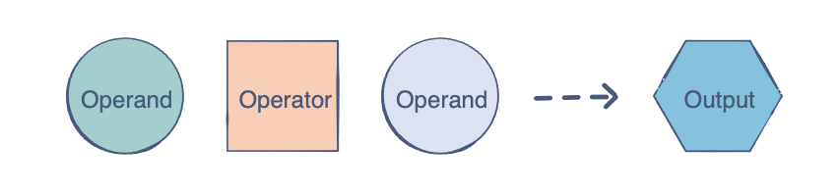
Binary Operators
These appear between two operands.
Example:
3 + 4 --> 7

Slide 10
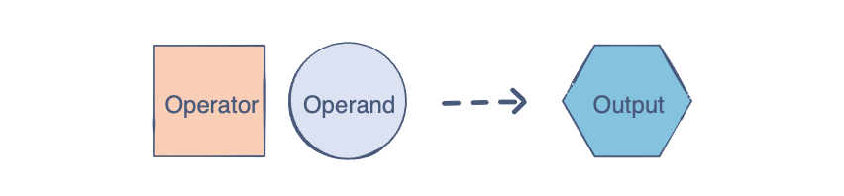
Unary Operators
These generally appear before an operand and only work on one.
Example:
4++ --> 5

Slide 11
Arithmetic Operators
Addition:
print(num1 + num2)
Subtraction:
print(num1 - num2)
Multiplication:
print (num1 * num2)
Division:
print (num1/num2)
num1 and num2 have to be a number.

Slide 12
Arithmetic Operators (cont.)
Floor Division:
print(num1 // num2)
Modulo:
print(num1 % num2)
Precedence is basically order of operations. This applies to coding as well.
The operation inside parentheses will be computed first no matter what the operation is.

Slide 13
Practice!
What will be displayed by this program?
num1 = 6
num2 = 7
Num1 = 8
print(num1 + num2)
13
15
14
None of the above
Correct answer: A. 13

Slide 14
Practice!
What will be displayed by this program?
num1 = 4
num2 = 8
num1 = 6
num3 = num1 + num2
print(num3 * 2)
24
20
28
None of the above
Correct answer: C. 28

Slide 15
Practice!
What will be displayed by this program?
num1 = 5
num2 = 2
num3 = num1 * num2
print(num1 + num3 * num2)
14
25
20
None of the above
Correct answer: B. 25

Slide 16
Practice!
What will be displayed by this program?
num1 = 4
num2 = 8
num3 = ((num1 + num2)/ num1)
num4 = 14%5
print(num3 + (num4//3))
5
6
4
None of the above
Correct answer: C. 4

Slide 17
Comparison Operators
The result will always be a boolean.
Comparison operators are binary operators.
Example:
value1 operator value2

Slide 18
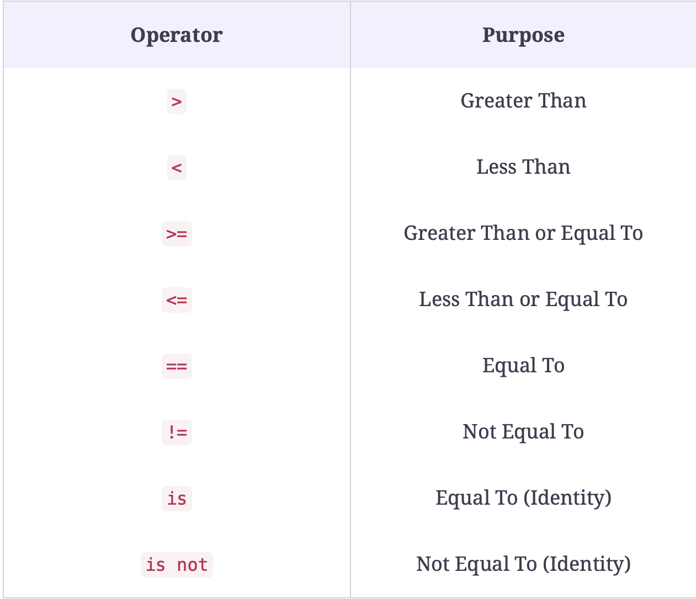
Comparison Operators (cont.)

Slide 19
Practice!
What will be displayed by this program?
phrase = “Hello”
word = “Hi”
len(phrase) >= len(word)
True
Yes
False
No
Correct answer: A. True

Slide 20
Practice!
What will be displayed by this program?
phrase = “Hello”
word = “Hi”
phrase[0] != word[0]
True
Yes
False
No
Correct answer: C. False

